Slide 1
Mojaloop PI-23
Recap - the value of an agile approach in the community context

Slide 2
INFITX
My name is Jane Stroucken, I am a Senior Program Manager and Agile Coach
at INFITX, and am happy to be presenting at this PI-23 community meeting.
INFITX is a motivated team of Inclusive Financial Technology eXperts focused on enabling equitable financial services.
My role is to support any member of the INFITX team and the Mojaloop community at large with workstreams and project implementation and to keep focus on the Agile approach.
The Foundation is a strong proponent of the Agile approach and on a simple level this can be seen in the PI approach, the collaborative Community meetings and workstreams.

Slide 3
Agenda
Why this session
Remember the Advantages of Agile
Are there disadvantages?
The story of the Banking app
Agile and Open Source

Slide 4
Why have this session?
Always good to reflect back to make sure we are on track - the retrospective principle
Do we remember some of the fundamental reasons for using an Agile philosophy?
Agile is a culture and only works if an entire community buys-in to the culture
Notes:
As the community grows it is important and valuable to ensure that the culture in the Community expands with the membership and remains strong and to our benefit,

Slide 5
Advantages of Agile
Customer satisfaction through fast and continuous delivery of useful software.
People and interactions are emphasized over processes and tools. Customers, developers and testers constantly interact with each other.
Working software is delivered frequently (weeks instead of months).
Face-to-face conversation is the best form of communication.
Close and daily cooperation between entrepreneurs and developers.

Slide 6
Advantages of Agile
6. Continuous attention to technical excellence and good design.
7. Regular adaptation to new circumstances. Even late changes to requirements are welcome.
8. Risk reduction and high quality end result.
9. Agility and efficiency in deliveries and in the execution of the project as a whole.
10. Flexibility to propose alternatives and reach the best possible solution.

Slide 7
Disadvantages?
The project can easily get sidetracked if the customer representative is unsure of the end result they want.
Agile developments also sometimes fail due to unrealistic expectations - what agile really is and what it can help you achieve. It is commonly believed that Agile is a set of practices, processes and tools, when in fact, Agile is really more of a mindset and culture.
Agile work requires a LOT of controls and interactive participation
Requires a mature, self-organising teams
Remote teams are challenging at the best of times
Technical debt can mount

Slide 8
The story of the Banking app
In 2012 Bank B launched its first ever Banking app, a new concept and importantly using a new methodology - Agile. They allocated a team just to this endeavour and they were exempt from following the usual release management and governance processes of the time. At the time of the launch it received a LOT of jeers and criticism for its ‘incompleteness’ and lack of competitiveness with the Bank PB who had launched its App a year earlier with a far greater set of features. That bank used traditional project management methods and old technologies. Still it’s app was impressive and innovative at the time.
3 years later the Bank B app was the most innovative, interactive and customer friendly app in the country and Bank PB was still trying to bring in new features.

Slide 9
The story of the Banking app…..
What had happened in the interim…..
Bank B was quietly and unceremoniously bringing out updates on the app that added new features, improvements and fixed bugs etc on a repetitive release cycle. Accommodating changes along the way with ease.
Before even they realised what had happened, the entire IT team at Bank B was working in an Agile fashion and focused on delivering incremental value to the client.
They had a roadmap…..it was very detailed for the immediate upcoming PI, fairly well understood for the next 2 PI’s and less and less detailed as the road extended further away.

Slide 10
The story of the Banking app……
What had happened in the interim…..
Bank PB was working extremely hard to perfect the next Banking Feature on the roadmap. It was complex and required many moving parts. The individual pieces were being developed within the banks complex programs and governance structure but milestones were difficult to meet as there were multiple integration issues. Time went by, budgets increased and milestone dates slipped but still they aimed for the perfect outcome.
Before even they realised what had happened, Bank B had a banking app that far outstipped Bank PB.

Slide 11
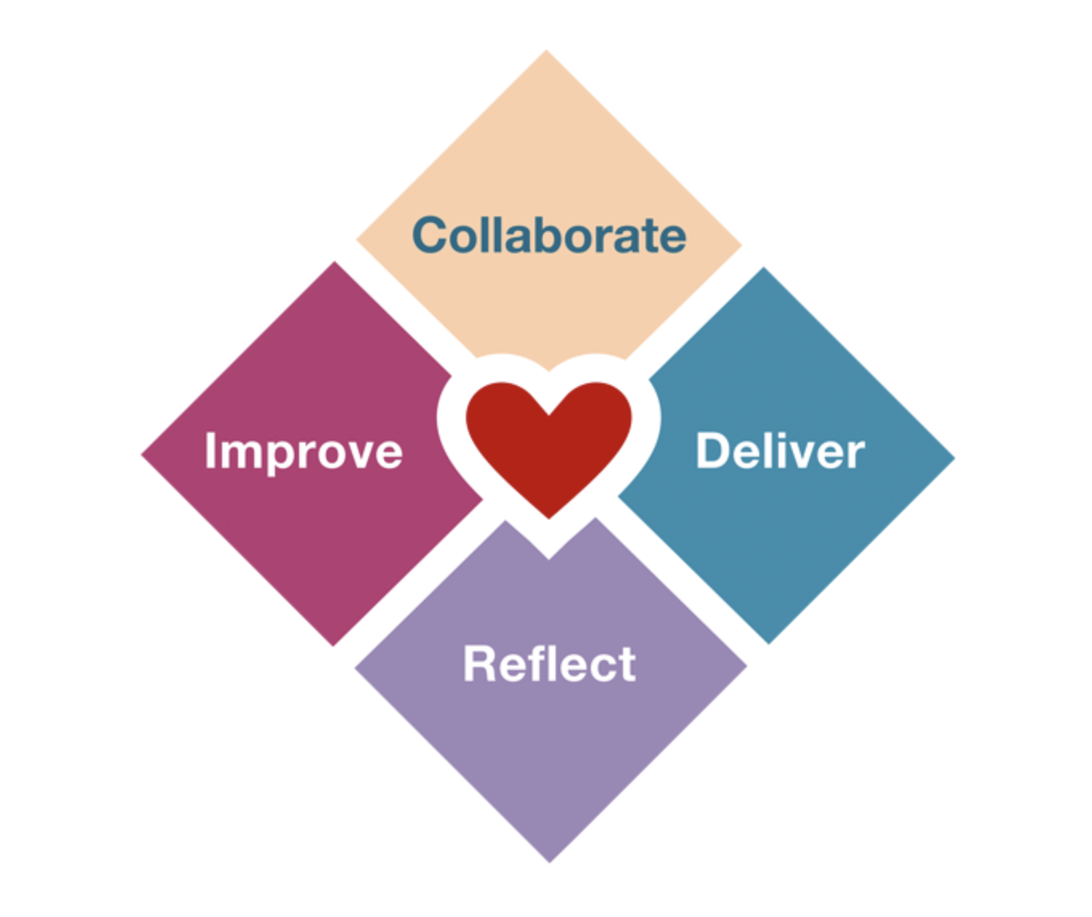
Agile and Open Source
These are compatible with open source values—open source is all about collaboration and delivering the result of that.
Reflection and improvement help us adapt to changes and provide the opportunity for an honest look in the mirror.

Slide 12
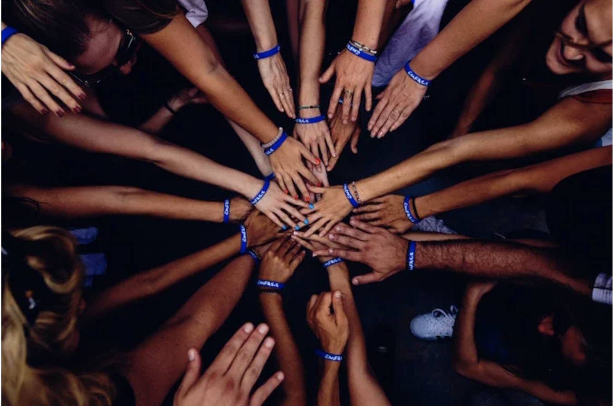
Building the Community is creating value
In agile, we talk a lot about creating value, the main idea being to simplify processes and focus on delivery.
A possible downside of this is that it can lead teams to focus only on delivering new features and not invest enough time to pay back technical debt or build on automation to facilitate the future growth of the project.
A way to avoid such a situation is to involve the team in defining what creating value actually means for the project.

Slide 13

How does that relate to open source?
For any team working in an open source community, it is crucial to understand that building and caring for that community creates value. In open source, the community is the heartbeat of a project—it provides crucial feedback, support, and documentation and contributes in many other ways.

Slide 14
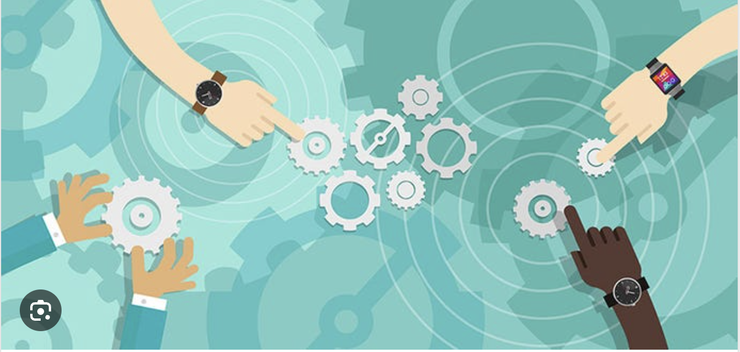
So, it is important to build in time and space for the community. Transparency, visibility and consistency are key.
Invite interested parties to participate in describing Epics, features and user stories
Invite people to review your user stories; after all, we do have users in our community.
Dedicate time to reviewing contributions, answering questions, providing support, etc.
Invite interested parties to observe your Sprint Review and ask questions of the team
All these should be part of the team's activities and be seen as valuable.

Slide 15
Mojaloop Agile Community
This is a vibrant, remote, hard-working and collaborative community let’s keep delivering Mojaloop by building and sustaining the community contributions through:
self-organised, disciplined and mature workstream teams
using the agile principles and processes that promote visibility and transparency
delivering regular value to the core in incremental releases
invitations to join session are real - so join in, observe and contribute - that is how you earn the right to air your views
and let’s ensure we continue to be part of the success story that is Mojaloop

Slide 16
Thank you

